Slide 1

Spotify
Top 200
Team Viper Francisco Zuluaga John Eagan
Kelvyn Guzman Rob Matelyan Ryan Sabon

Slide 2
Agenda
Hypothesis
Big Picture Analysis
Audio Analysis
A Closer Look
Conclusion

Slide 3
Hypothesis

Slide 4
Theme
Theme: We set out to identify any change in trends within Spotify Top 200 music streaming charts from 2019 to 2020 due to world events such as, the Covid-19 pandemic.
Hypothesis: Music streaming volume is likely to increase and patterns in users’ music selection will shift to more tracks that are lower in energy, less dancible, and overall have a more sorrowful mood.
Approach:
Python
Pandas
Matplotlib
Seaborn
Spotify API

Slide 5
Big Picture Analysis

Slide 6
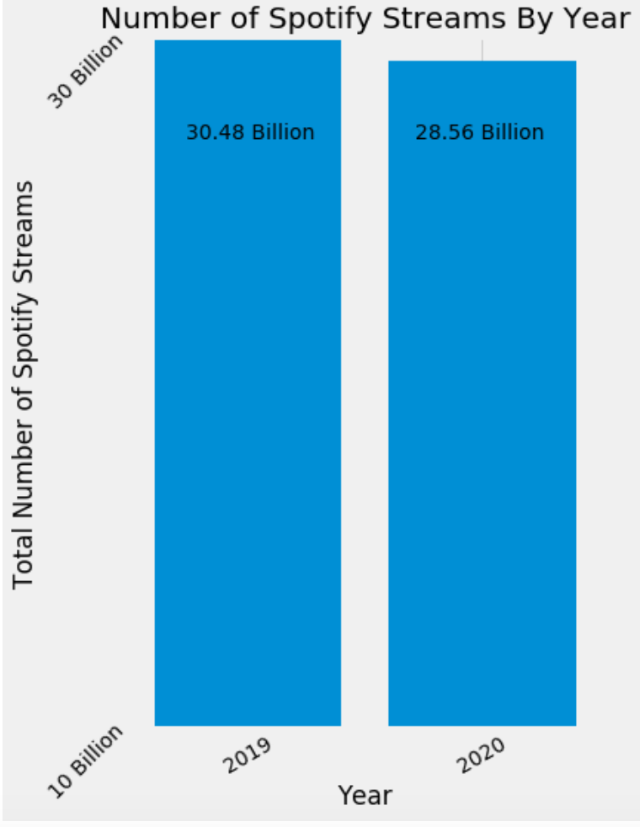
Total Streams by Year
There were 1,916,069,581 less streams in 2020 than in 2019
This is a decrease of 6.5% YoY
Possible explanations:
Commuting to work
Going to the gym
Traveling in general
Concerts/Festivals
Method: combined the US top weekly top 200 streaming data and merged it into a master sheet

Slide 7
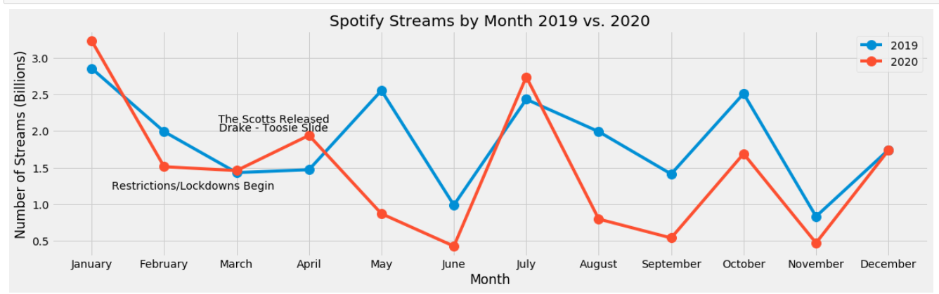
2019 vs 2020 Monthly Streams
California and the northeast had restrictions/lockdowns from March end of 2020
Start to see streaming decrease April & May 2020
April 2020
Drake “Toosie Slide” released
“The Scotts” by Travis Scott and Kid Cudi released
~8% of streams in April 2020

Slide 8
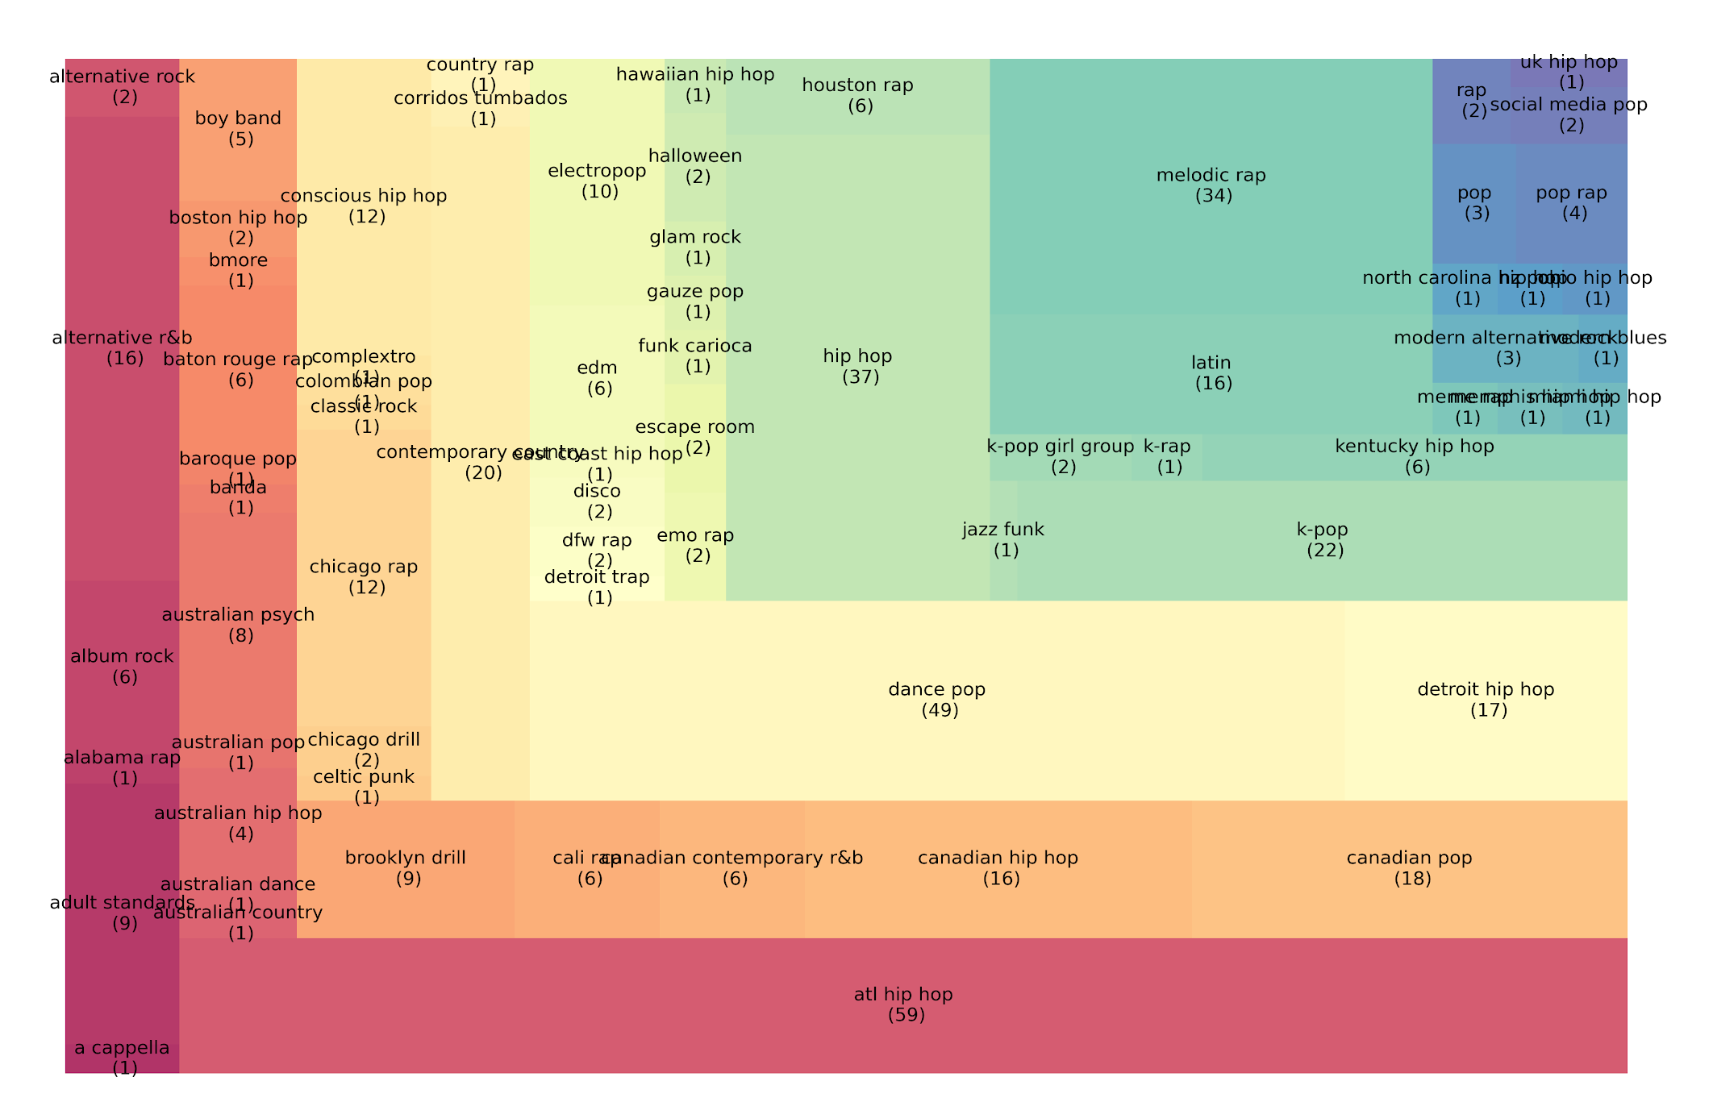
Top Genres of 2020
Spotify has over 5,000 distinct genres
2020 had 19 more total artists and 111 more total tracks than 2019
70 different genres appeared on the Top 200 charts

Slide 9
Audio Analysis
Notes:
Asked ourselves how certain audio features like danceability, loudinses and others changed over the 2019 -2020 period so we needed to see what audio features were highly correlated.

Slide 10
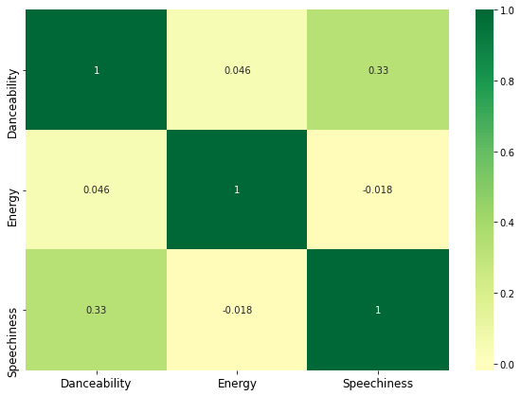
Correlation between Spotify music features
Danceability and energy are highly correlated
Other music features are not statistically significant
Energy and speechiness are negatively correlated
Presenter: John

Slide 11
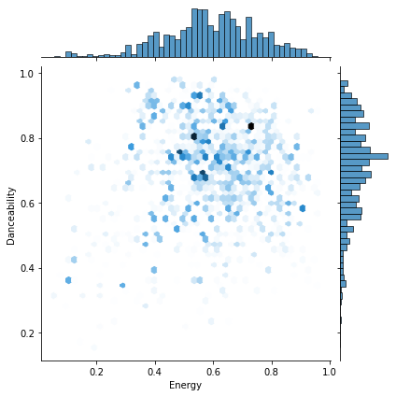
Correlation between Energy and Danceability (2019 vs. 2020)
2019
2020
Presenter: John

Slide 12
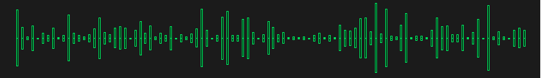
Audio Analysis in USA, Sweden and Italy
Valence: A measure from 0.0 to 1.0 describing the musical positiveness conveyed by a track. Tracks with high valence sound more positive (e.g. happy, cheerful, euphoric), while tracks with low valence sound more negative(e.g. sad, depressed, angry).
Acousticness
Danceability
Energy
Instrumentalness
Liveness
Speechiness
Presenter: Kelvyn

Slide 13
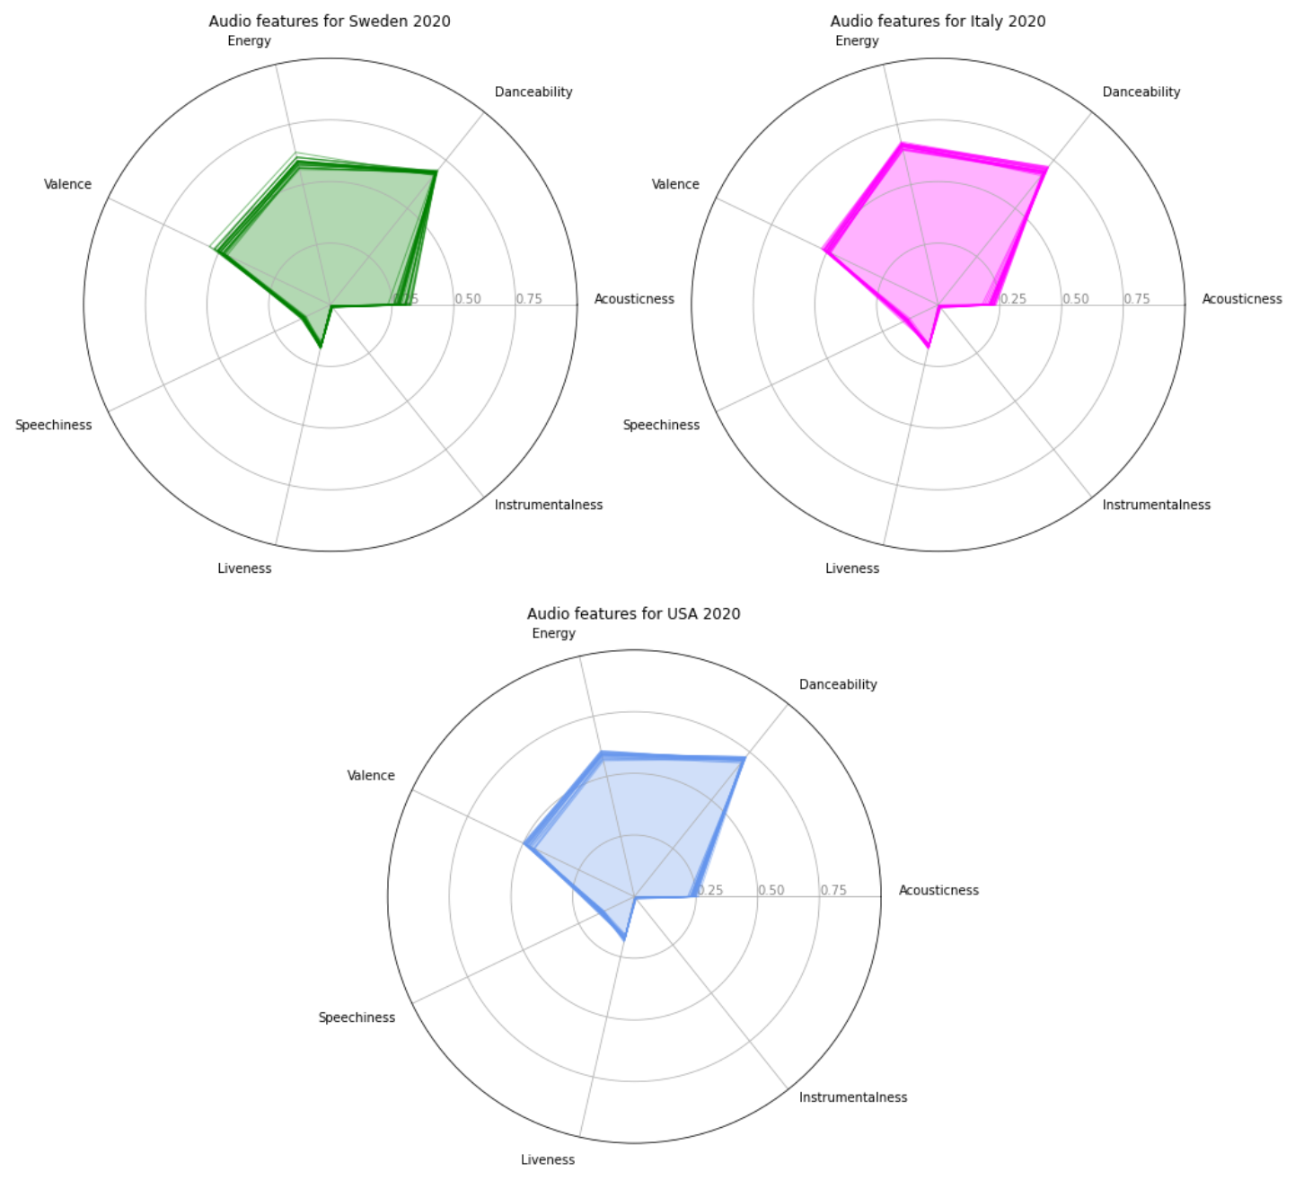
Music Mood 2020 (Sweden, Italy & USA)
Presenter: Kelvyn
Radar Plot
Notes:
This data is within the first 6 months of the year 2020.

Slide 14
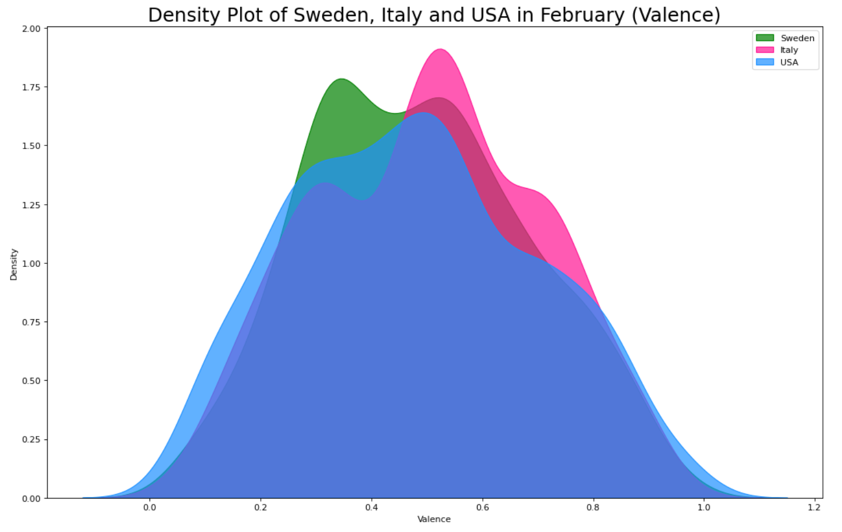
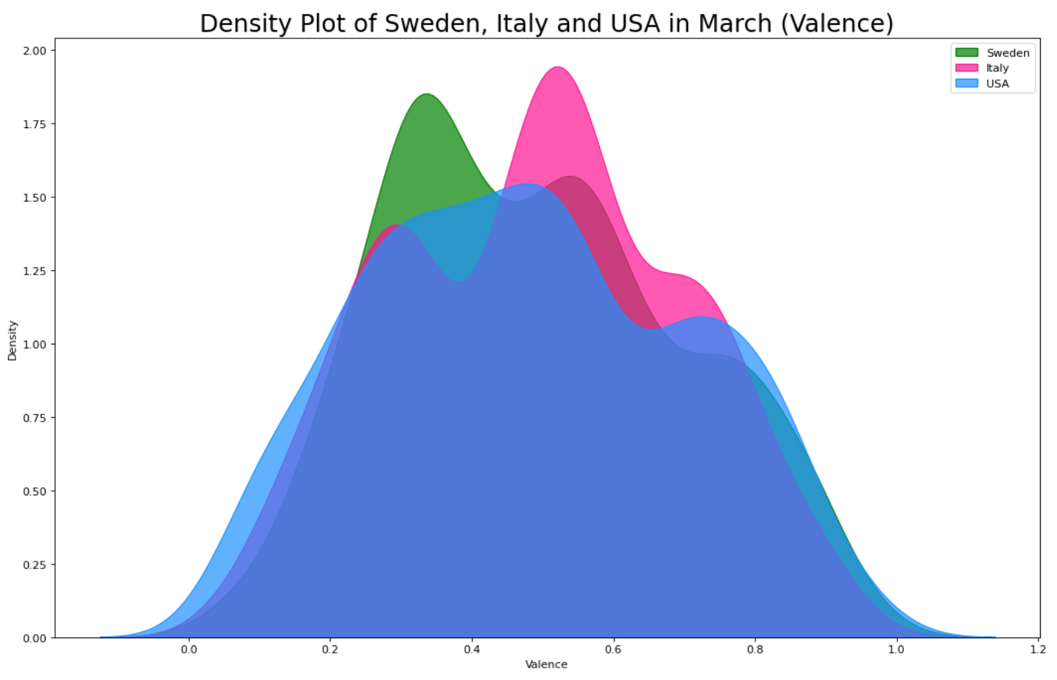
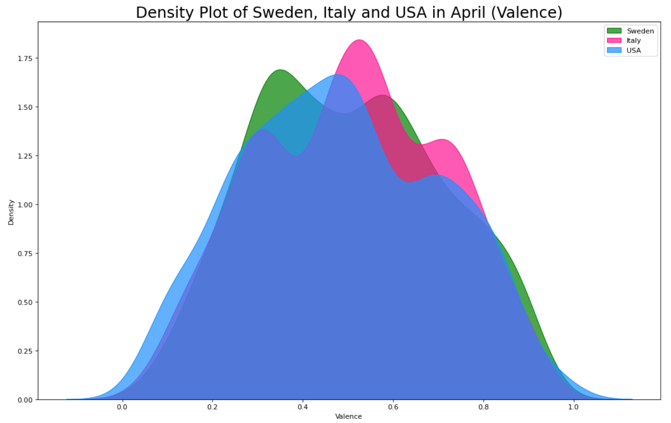
Density Plot per Month for Sweden, Italy & USA
Presenter: Kelvyn
Density Plot

Slide 15
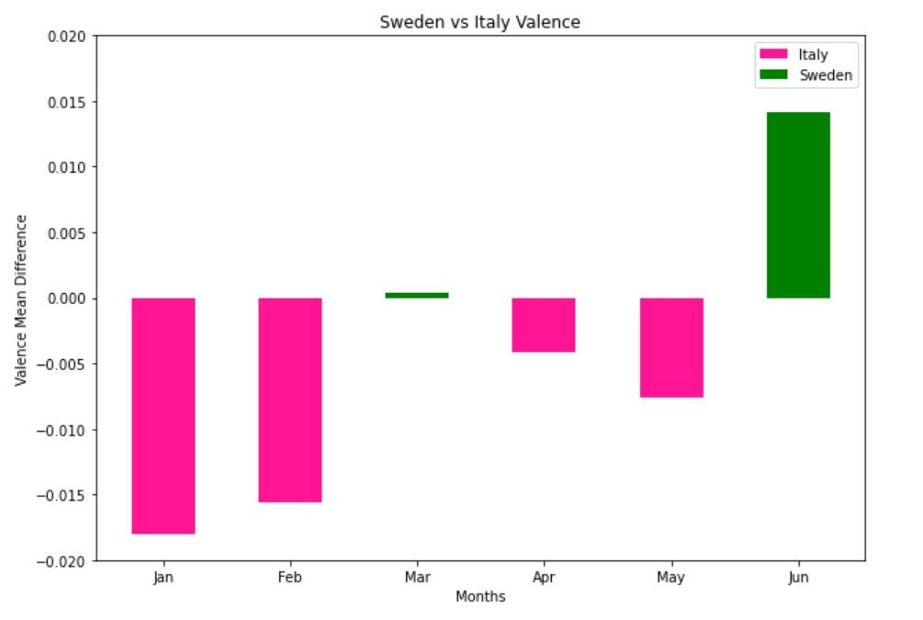
Valence Mean Difference (Sweden vs Italy)
Presenter: Kelvyn
Bar Plot

Slide 16
A Closer Look: The Weeknd

Slide 17
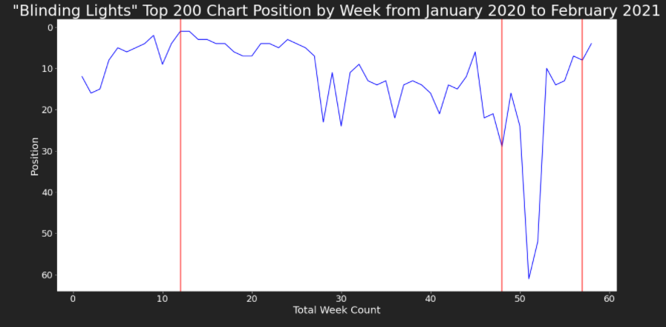
“Blinding Lights” by The Weeknd
Key Events
Album Released: March 20th, 2020
Performed at the AMA’s: November 22nd, 2020
Super Bowl LV Halftime Performance: February 7th, 2021
Notes:
Tracked Blinding Lights by The Weeknd from January of 2020 to mid-February 2021
Highlighted 3 Key events related to the song
The song reaches its peak chart position (1st) when the Album officially releases
The Weeknd performed at the American Music Awards on November 22nd, 2020 and shortly after the song’s chart position drops drastically from 24th to 61st. This is most likely due to an increase in Holiday Music streaming in December.
Leading up to The Weeknd’s Super Bowl LV Halftime performance, the song’s position continues to increase and the days after the Super Bowl performance, the song reaches 4th on the top 200 chart
There is no clear effect on the ranking of the song caused by the pandemic.

Slide 18
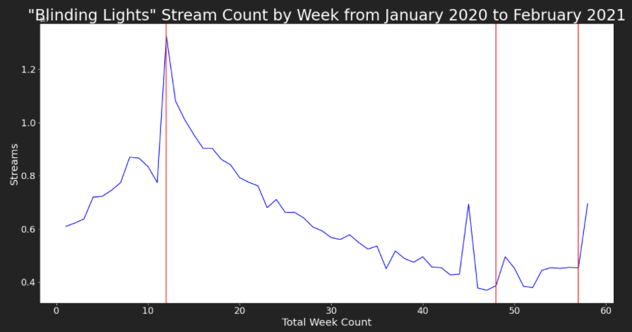
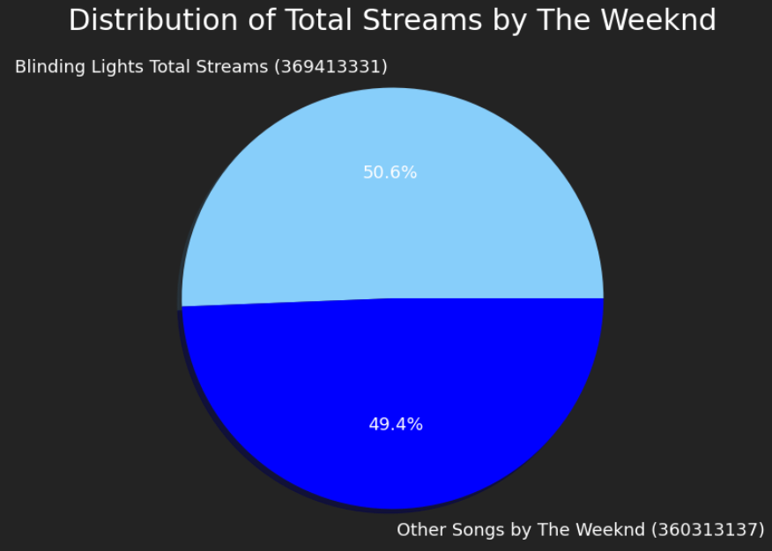
“Blinding Lights” by The Weeknd
Notes:
During the week of March 20th when the Weeknd’s album, After Hours was released, his hit song ‘Blinding Lights’ reaches a peak in total streams in that particular week of 13,245,312 streams.
The song trends downward following the release of his album and sees consistent speaks leading up to his live performances at major events including

Slide 19
Conclusion

Slide 20
Conclusion
Our analysis indicates inconsistencies between actual results and initial hypothesis
While streaming slightly decreased in 2020, there was an increase in total artists and genres appearing on the Weekly Top 200 Chart
There was no major change between certain technical audio elements such as danceability, energy and spechiness
There was no major difference in the “moods” of streams between countries that responded to the pandemic differently
As shown with the deep dive into the Blinding Lights by The Weeknd we see how other events impact streaming volume and streaming behavior more than the pandemic
Possible Limitation of the Dataset: No visibility beyond the Top 200 Chart

Slide 21
Questions?

Slide 22
Appendix

Slide 23
Spotify Defined Elements
Danceability: Danceability describes how suitable a track is for dancing based on a combination of musical elements including tempo, rhythm stability, beat strength, and overall regularity. A value of 0.0 is least danceable and 1.0 is most danceable.
Energy: Energy is a measure from 0.0 to 1.0 and represents a perceptual measure of intensity and activity. Typically, energetic tracks feel fast, loud, and noisy. For example, death metal has high energy, while a Bach prelude scores low on the scale. Perceptual features contributing to this attribute include dynamic range, perceived loudness, timbre, onset rate, and general entropy.
Speechiness: Speechiness detects the presence of spoken words in a track. The more exclusively speech-like the recording (e.g. talk show, audio book, poetry), the closer to 1.0 the attribute value. Values above 0.66 describe tracks that are probably made entirely of spoken words. Values between 0.33 and 0.66 describe tracks that may contain both music and speech, either in sections or layered, including such cases as rap music. Values below 0.33 most likely represent music and other non-speech-like tracks.
Valence: A measure from 0.0 to 1.0 describing the musical positiveness conveyed by a track. Tracks with high valence sound more positive (e.g. happy, cheerful, euphoric), while tracks with low valence sound more negative (e.g. sad, depressed, angry).
Acousticness: A confidence measure from 0.0 to 1.0 of whether the track is acoustic. 1.0 represents high confidence the track is acoustic.
Instrumentalness: Predicts whether a track contains no vocals. “Ooh” and “aah” sounds are treated as instrumental in this context. Rap or spoken word tracks are clearly “vocal”. The closer the instrumentalness value is to 1.0, the greater likelihood the track contains no vocal content. Values above 0.5 are intended to represent instrumental tracks, but confidence is higher as the value approaches 1.0
Liveness: Detects the presence of an audience in the recording. Higher liveness values represent an increased probability that the track was performed live. A value above 0.8 provides strong likelihood that the track is live.
Notes:
Consider Moving this slide to prior to the Music analysis section

